Slide 1
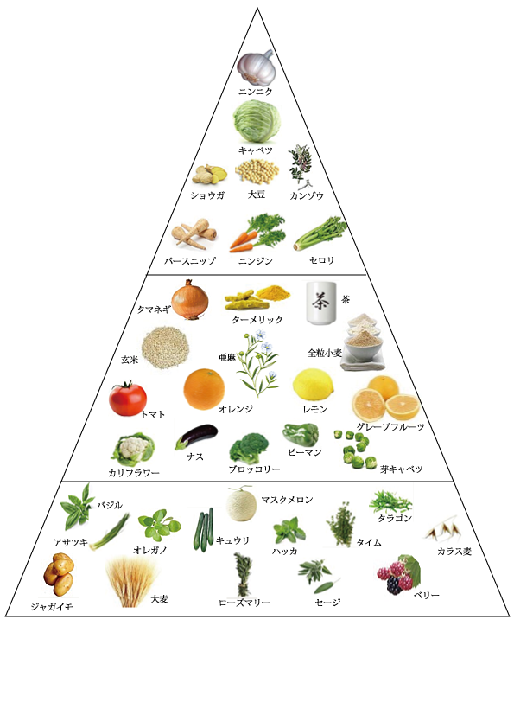
フードピラミッド(Food Pyramid)

Slide 2
Unit Plan: Food Pyramid
Lesson 1:
Vocabulary for items of food, and your food favorites and dislikes
Lesson 2:
Eat wise and healthy, and compare food between U.S. and Japan
Lesson 3:
Make your own lunch with healthy food choices
Lesson 4:
Make a recipe of popular Japanese dish
Lesson 5:
Cook the dish with home economics teacher
GO!

Slide 3
Lesson 1:
Vocabulary for items of food
and
your food favorites and dislikes

Slide 4


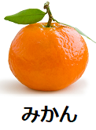


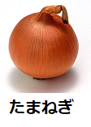

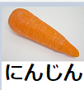
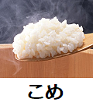
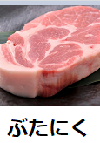
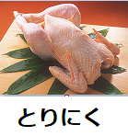
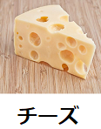
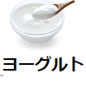
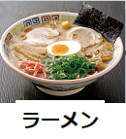

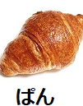

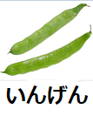

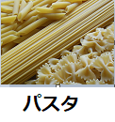
Vocabulary for items of food, and your food favorites and dislikes
Let’s go to the dialog page!

Slide 5
Dialog 1 with the instructor
T: これはどこですか。 Kore wa doko desu ka. Where does this item go?
S: A です。 A desu. It is category A.
T: Ａはなんですか。 A wa nan desu ka. What does category A describe?
S: やさいです。 Yasai desu. It is a vegetable.
T: いいですね。 Ii desu ne. Good.
Lets go to the food pyramid to practice these dialogs!

Slide 6
Dialog 2 in pair
S1: すきなたべものはなんですか。
Suki na tabemono wa nan desu ka. What is your favorite food?
S2: バナナです。あなたは。Banana desu. Anata wa. It is a banana. And you?
S1: パスタです。 Pasuta desu. It is pasta.
S2: きらいなたべものはなんですか。
Kirai na tabemono wa nan desu ka. What is a food that you dislike?
S1: やさいです。 Yasai desu. Vegetables.

Slide 7
For your homework
Lesson 1
Listen to and repeat the words and dialog
Practice writing the words

Slide 8

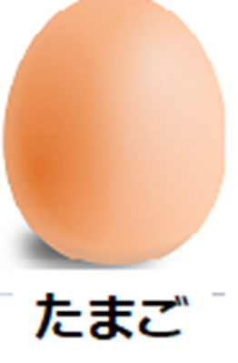






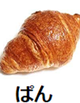


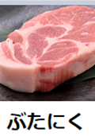


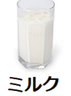
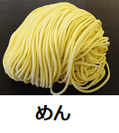
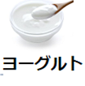
Listen to and repeat the following words.

Slide 9



Slide 10


Slide 11
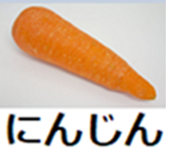

Slide 12


Slide 13
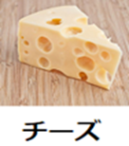

Slide 14
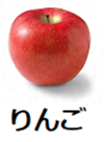

Slide 18


Slide 29
Dialog 1 with the instructor
T: これはどこですか。 Kore wa doko desu ka. Where does this item go?
S: A です。 A desu. It is category A.
T: Ａはなんですか。 A wa nan desu ka. What does category A describe?
S: やさいです。 Yasai desu. It is a vegetable.
T: いいですね。 Ii desu ne. Good.
Let’s go to the food pyramid to practice these dialogs!

Slide 30
Dialog 2 in pair
S1: すきなたべものはなんですか。
Suki na tabemono wa nan desu ka. What is your favorite food?
S2: バナナです。あなたは。Banana desu. Anata wa. It is a banana. And you?
S1: パスタです。 Pasuta desu. It is pasta
S2: きらいなたべものはなんですか。
Kirai na tabemono wa nan desu ka. What is a food that you dislike?
S1: やさいです。 Yasai desu. Vegetables.

Slide 31
Lesson 2:
Eat wise and healthy
and
compare food between U.S. and Japan

Slide 32
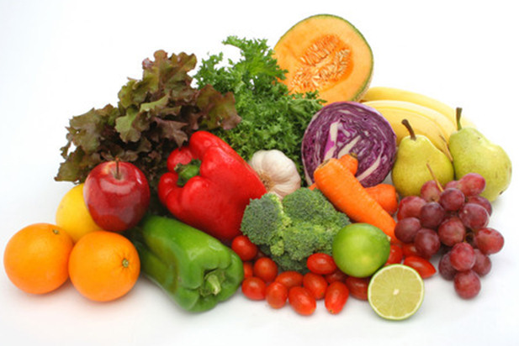
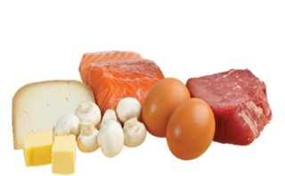
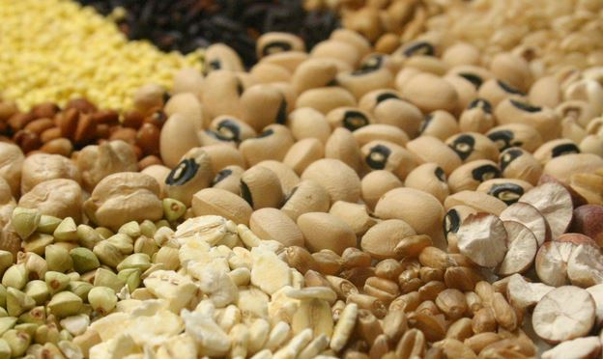
Eat wise and healthy, and compare food between U.S. and Japan
School Food: Japan and the United States
Posted on February 26, 2016 by Columbiafpop
More activities are coming up soon!

Slide 33
Lesson 3:
Make your own lunch with healthy food choices

Slide 34
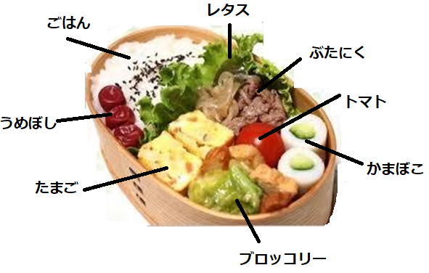
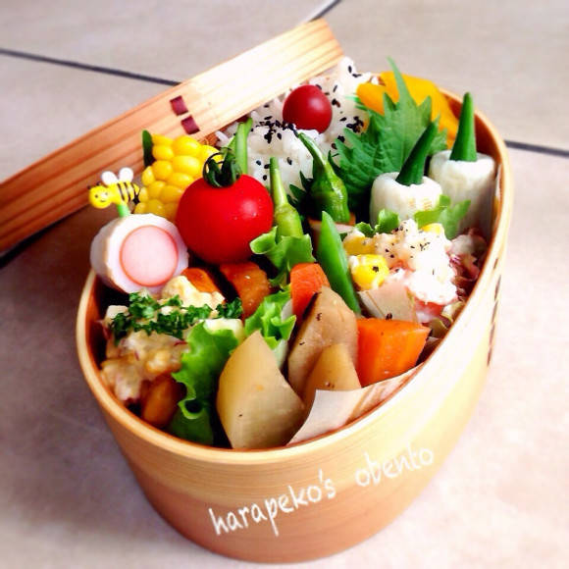
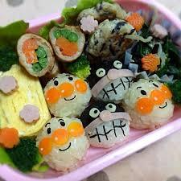
Make your own lunch with healthy food choices
Design and draw your lunch using color pencils. The ingredients
will be your choices and label the ingredients as below.
Describe why you chose the food as much as possible
More activities are coming up soon!

Slide 35
Lesson 4:
Make a recipe of popular Japanese dish

Slide 36
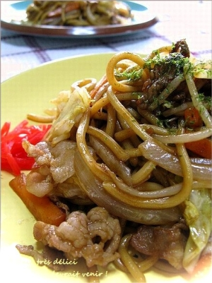
Make a recipe of popular Japanese dish
Do your own!
Sample recipe
材 料（２人分）
中華麺（焼きそば用）２玉
豚バラ肉１２０ｇ
キャベツ大２～３枚
たまねぎ１/２個
にんじん少々
もやし８０ｇ
オリーブオイル大さじ1
・・調味料 Ａ・・
ウスターソース大さじ３
酒大さじ１
トマトケチャップ大さじ２
鶏ガラスープの素ふた摘み
・・・・・・・・
塩、こしょう少々
青海苔、紅生姜各適量

Slide 37
Lesson 5:
Cook the dish with home economics teacher

Slide 38
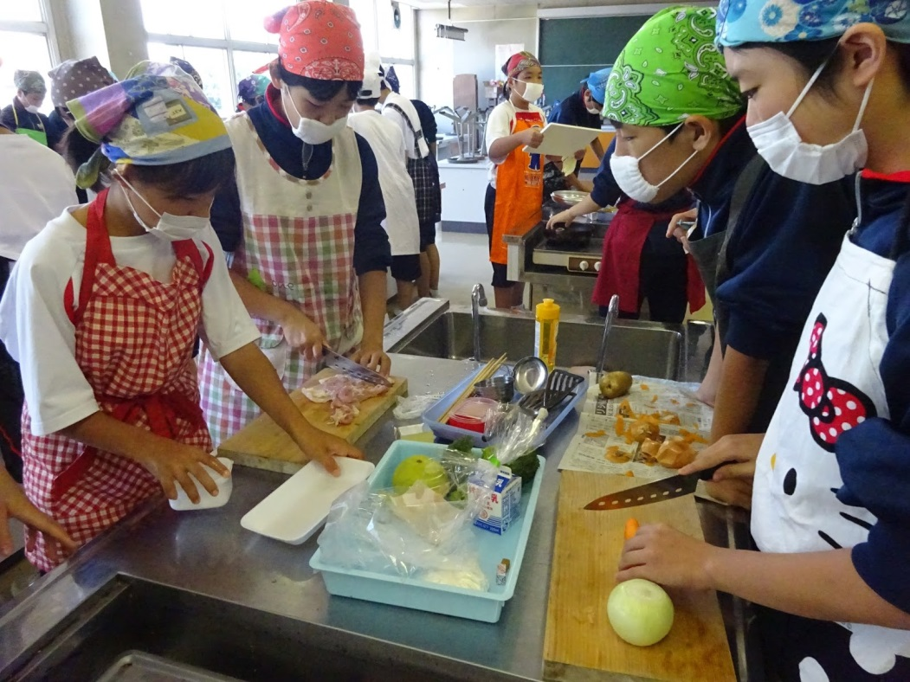
Cook the dish with home economics teacher
Sample website for Yakisoba
Sample YouTube page for Yakisoba

Slide 39

Next unit will be family!

